Slide 1
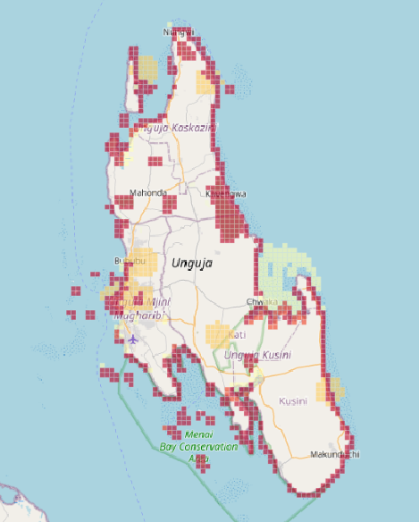
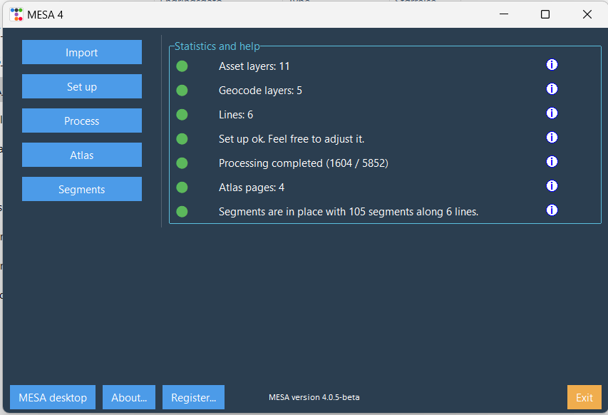
MESA – upgrade

Slide 2
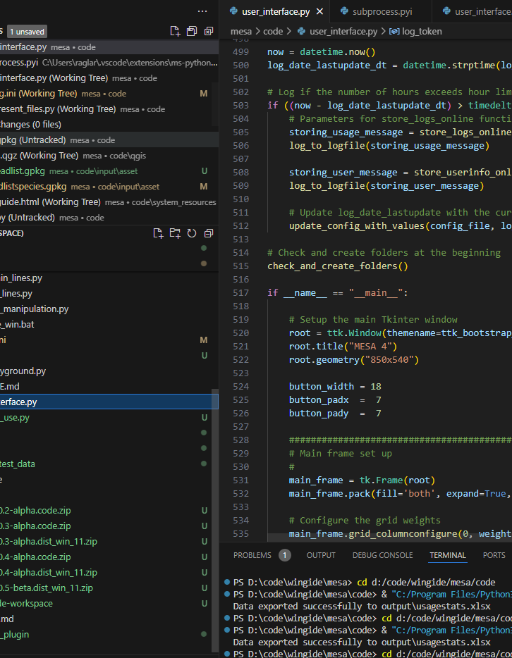
MESA 4.0 – why?
The online version is difficult to maintain. It is also expensive to run due to licenses and cloud costs
My impression is that the online solution was:
Not much used and
not flexible enough for the users.
I had the means and the time.

Slide 3
MESA 4.0 – gives us?
Most of the online functionality is available
«Local» development
Looks like the processing is faster
Better QGIS template

Slide 4
MESA 4.0 – what now?
Update test data set
More/better documentation:
Allow some partners to test this version.
Gather feedback
Move to release version
Involvement from WCMC?

Slide 5
Resources
Github: https://github.com/ragnvald/mesa
Documentation wiki: https://www.mesamethod.org/wiki/Current_tool_version

Slide 6
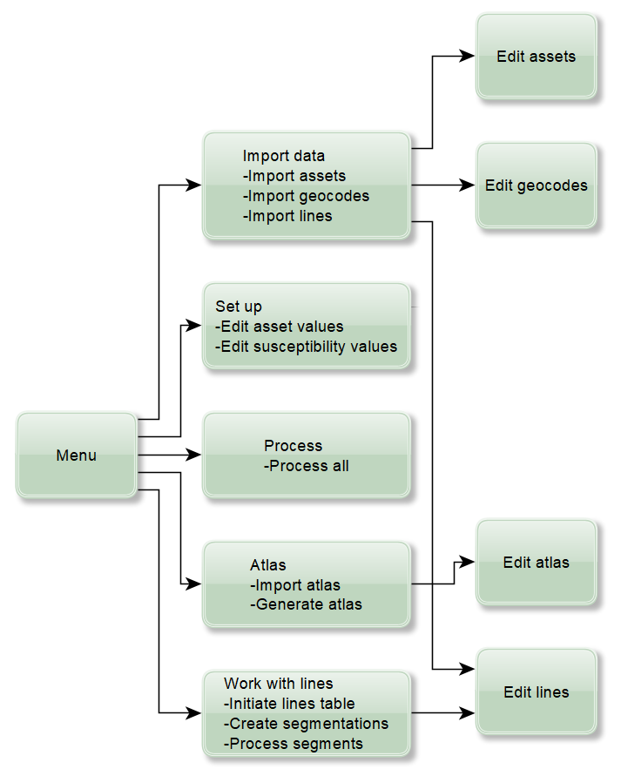


Slide 7
Process reminder
Import data
Renaming of asset names
Set up processing
Asset values
Process data
Susceptibilities
Renaming of geocode names
Template which shows data
QGIS
Files ready to be used with QGIS

Slide 8
Short demo

Slide 9
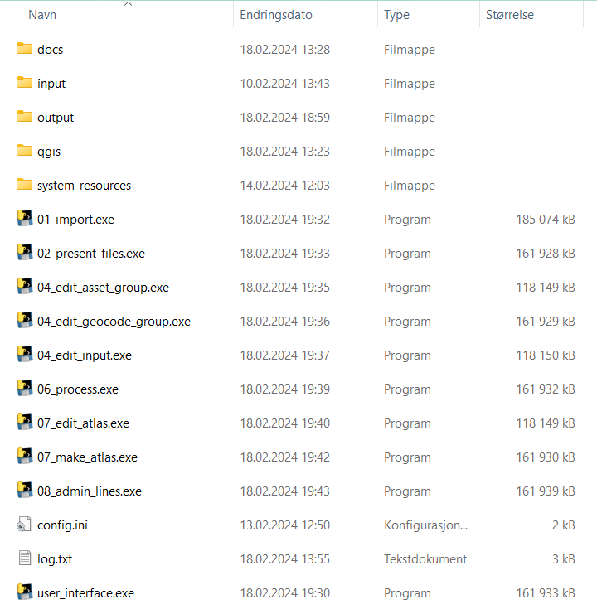
How do I start using it?
Download the zip-file
Unzip
Double-click the file:
user-interface.exe

Slide 10
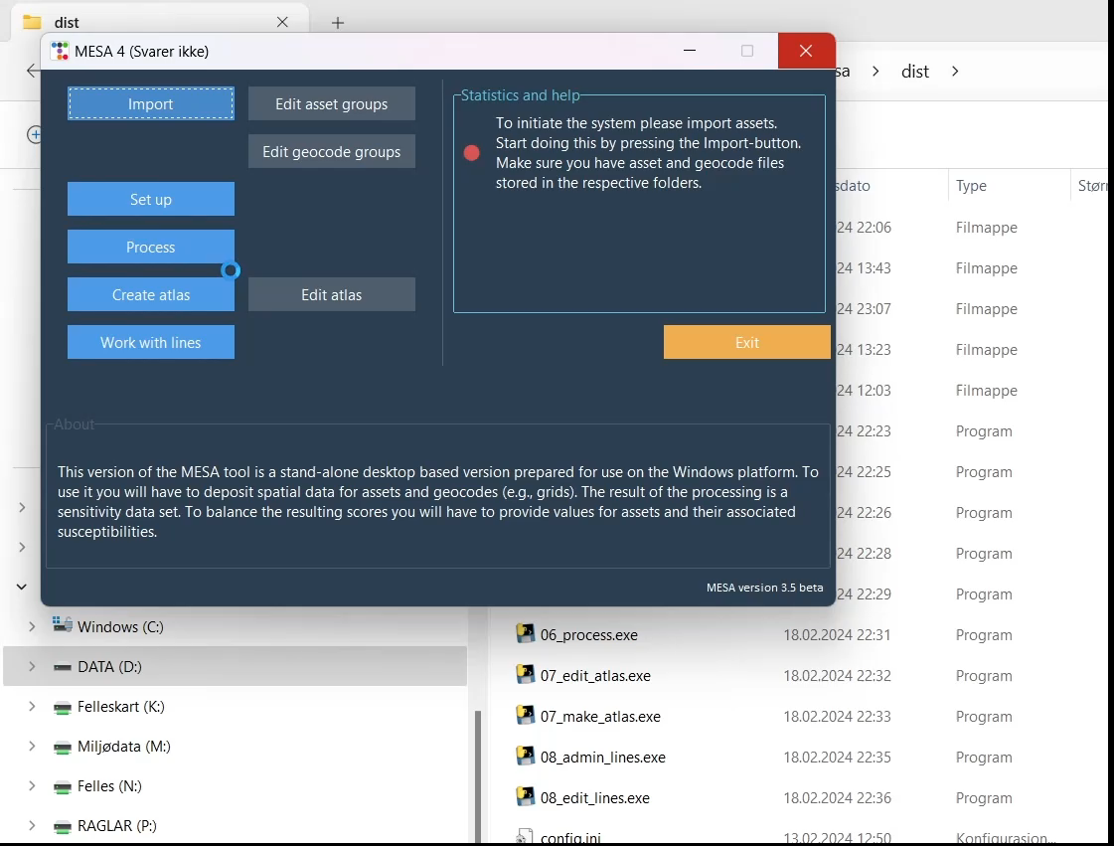

Slide 11
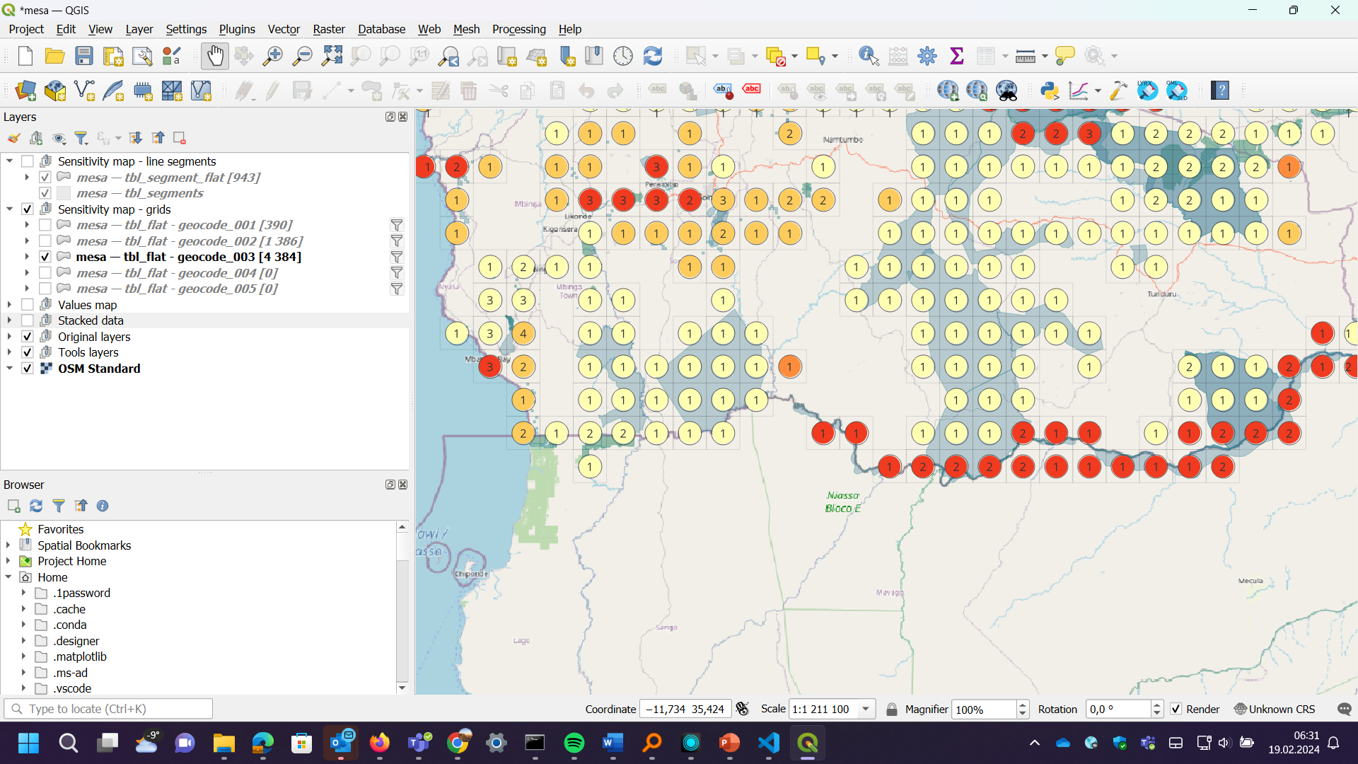

Slide 12
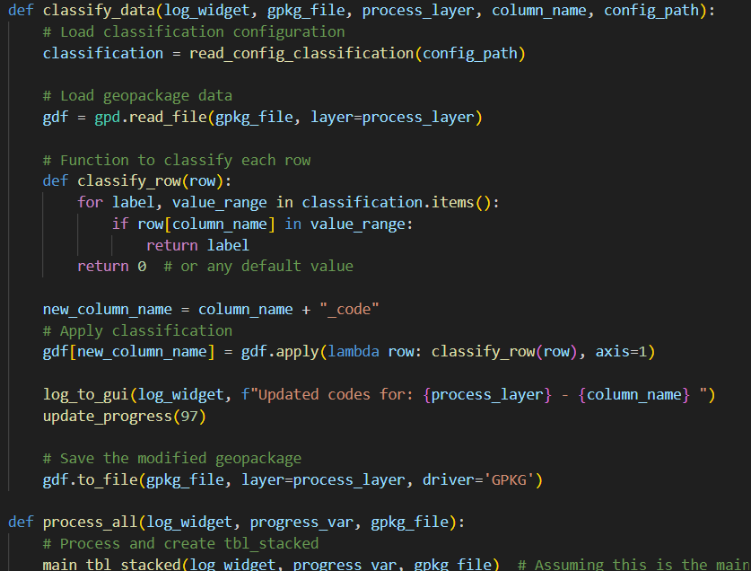
For the nerds…
Programming language is Python 3.11
5000 lines of code
Many libraries (predefined resources)
Can be used on Windows, Linux and MacOS
Made with a little help from ChatGPT

Slide 13
Lines -> segments - I
Segments in part answers to the challenge the coastal administration gave us.
Lines imported to the system are buffered and segmented.
Their default sizes are defined in the config.ini-file. But you can edit their sizes from within the program when you are «Work with lines»
The result is pretty much like the geocodes.

Slide 14
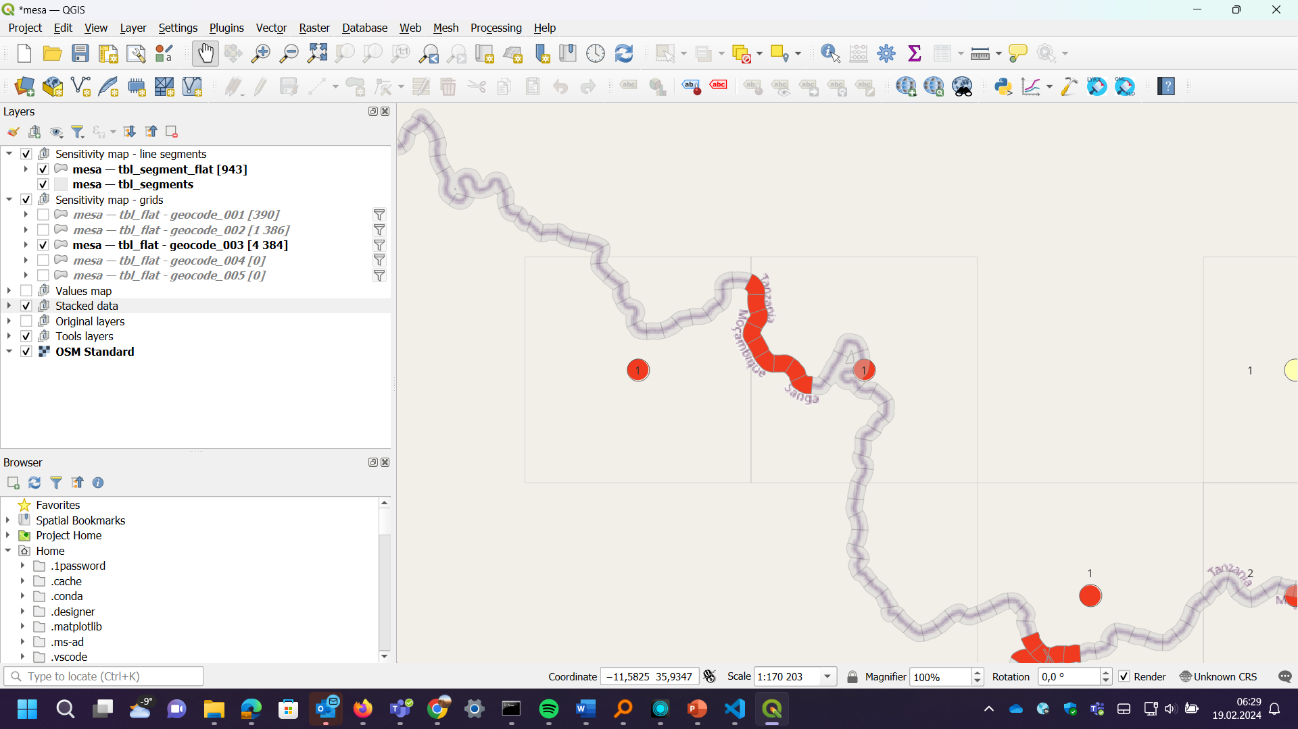

Slide 15
Lines -> segments - II
Note how the grid cells generalise more than the line segments.
Used along the coastline, at the right segment size, they could be a good illustration.
In the example used here I have only used a river as a line.

Slide 16
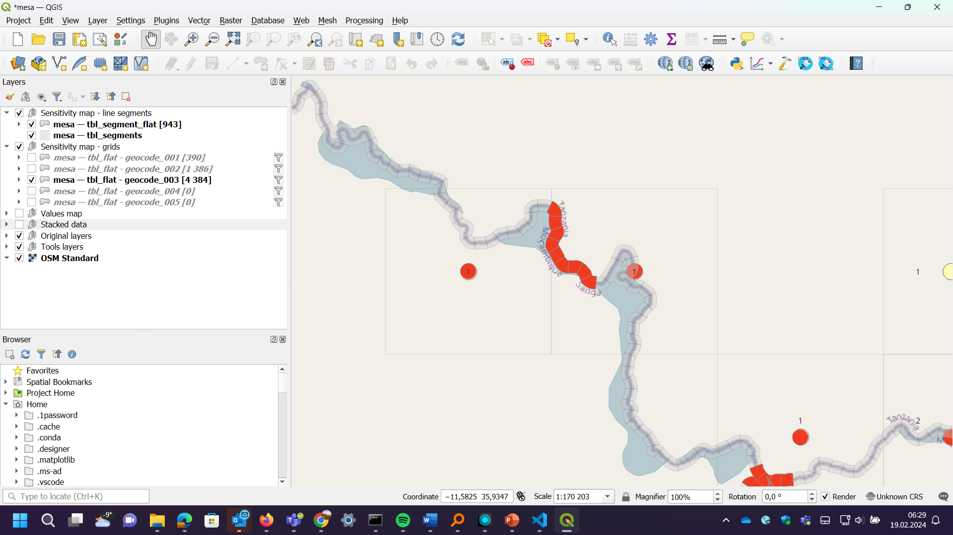

Slide 17
Grid cells and lines
Could be combined like shown in the next map

Slide 18
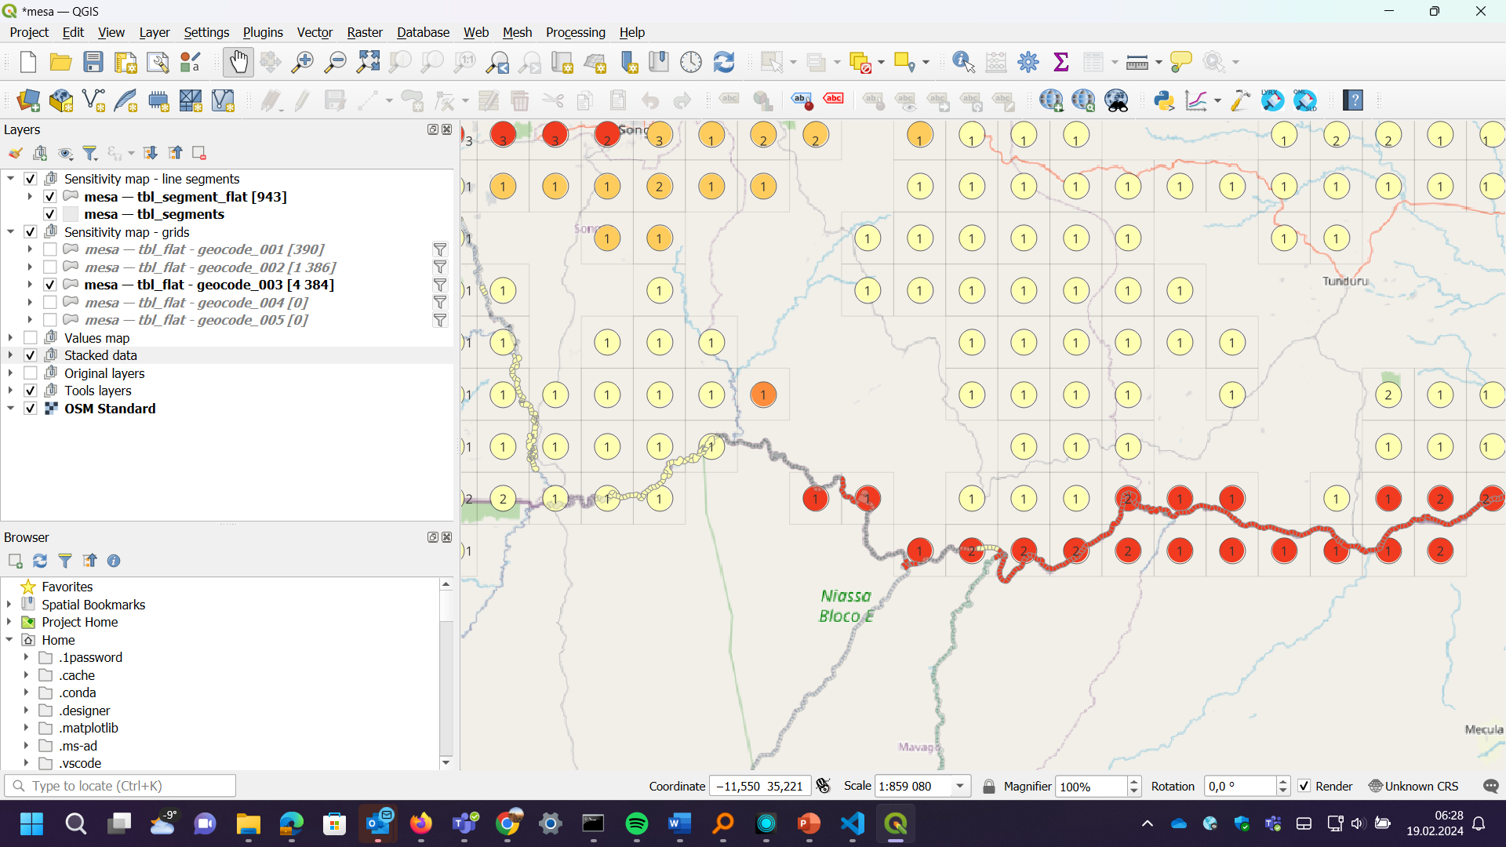

Slide 19
Grid cells and lines atlases
QGIS is set up to support atlases for both line segments and atlases (like before)
Default layout need some work.

Slide 20
